Slide 1
A HOROSCOPE YOU CAN ARGUE WITH
Kundlibash
A horoscope you're allowed to argue with.
✦
Take your horoscope with a pinch of celestial salt
Cloudflare Pages · Functions · KV — built with Claude Code

Slide 2
✦
THE PROBLEM
Everyone reads it.
No one checks it.
“my horoscope is
complete bs.”
The horoscope is written in the morning and forgotten by night. It never has to be right — just vague enough to feel right, and gone before you can call its bluff.
— the instinct we build on
Read
Checked
Graded
EVERY MORNING
ALMOST NEVER
NEVER
KUNDLIBASH
02

Slide 3
✦
THE IDEA
Make it falsifiable. Make it fun.
I
II
III
Predict
Bash
Reckon
Pull each sign's real daily horoscope and split it into discrete, testable lines.
At day's end, mark each line rang true or rang hollow — and note what actually happened.
Verdicts roll up into your private record and a public scoreboard of the whole zodiac.
KUNDLIBASH
03

Slide 4
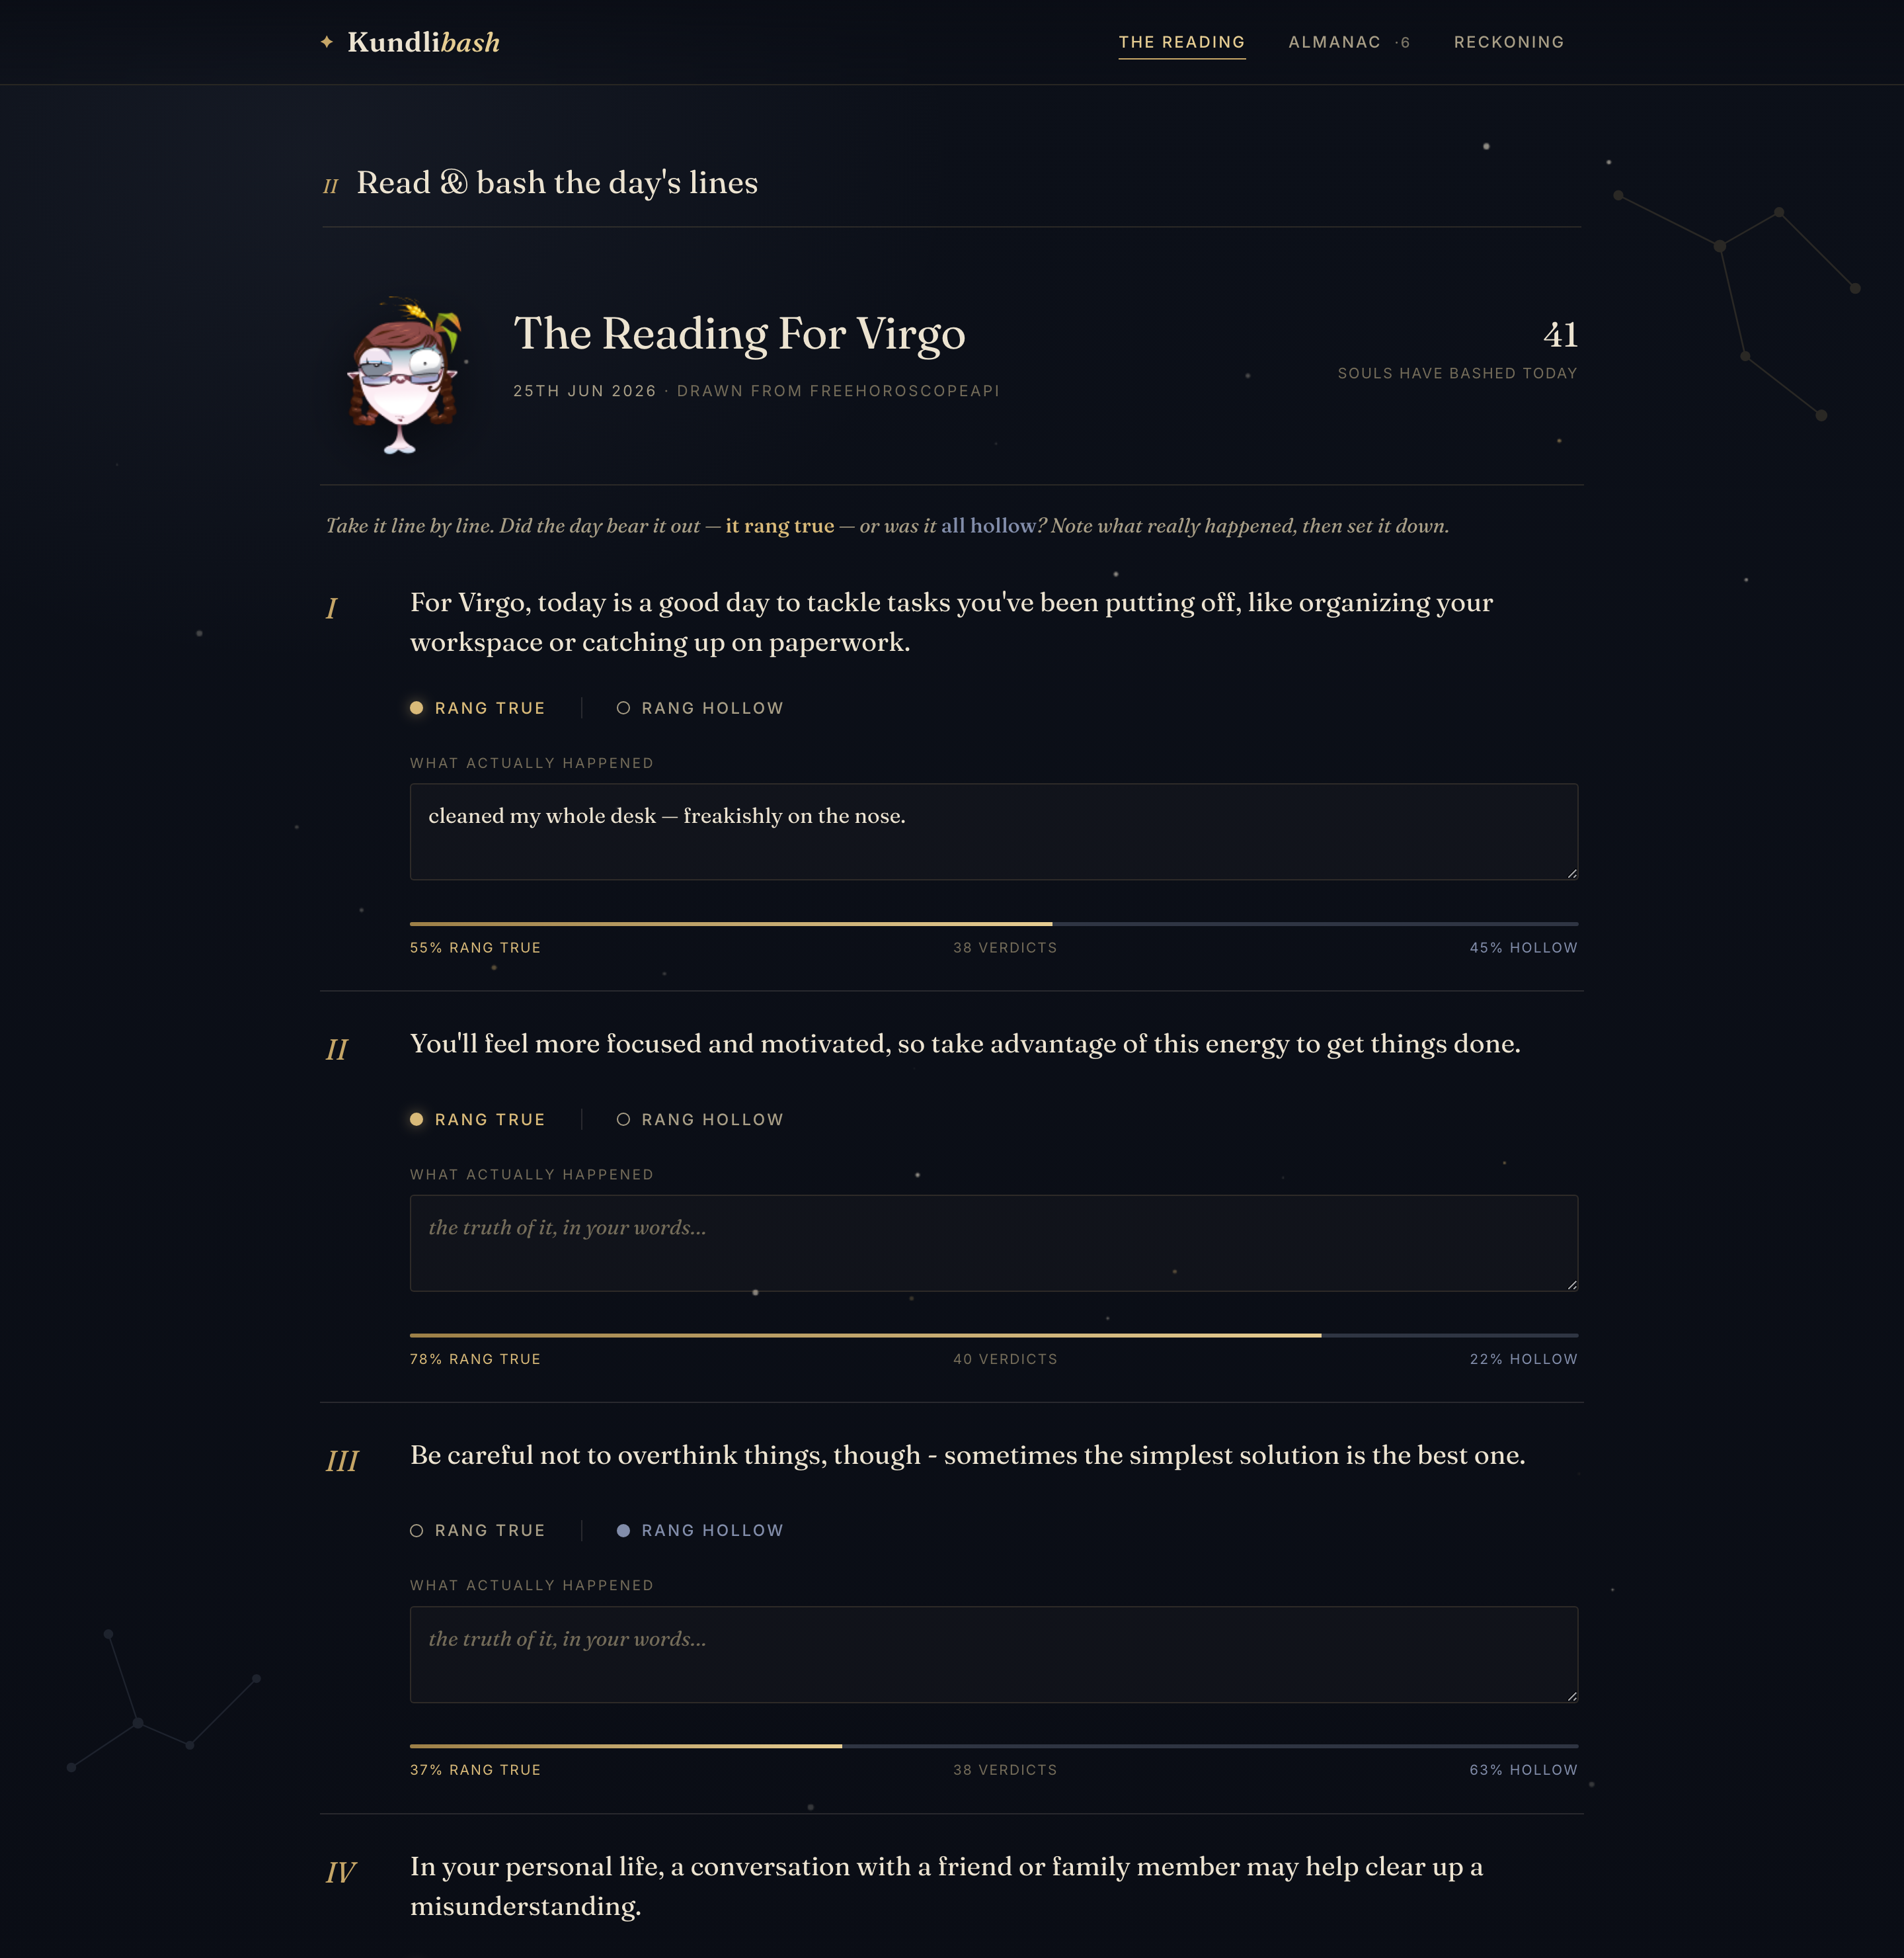
✦
THE READING
Bash the stars, line by line.
✦
Choose your sign.
✦
Read today's lines — the same for everyone with your sign.
✦
Mark each true or hollow; note what really happened.
✦
Watch the crowd's verdict appear beneath each line.
KUNDLIBASH
04

Slide 5
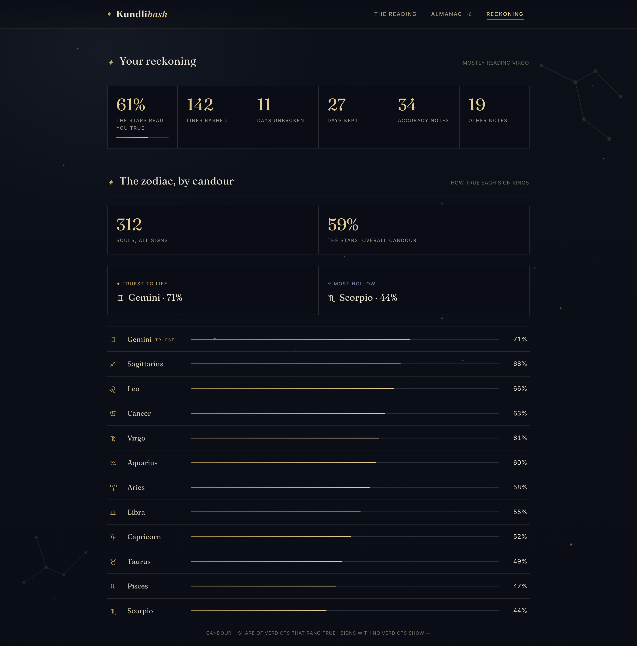
✦
THE RECKONING
A scoreboard for the stars.
Because everyone with your sign reads the same daily lines, the verdicts add up to something real — a live, crowd-sourced measure of which signs ring true, and which are mostly hot air.
Gemini rings 71% true. Scorpio, just 44%.
THE STARS' OVERALL CANDOUR — 59%
KUNDLIBASH
05

Slide 6
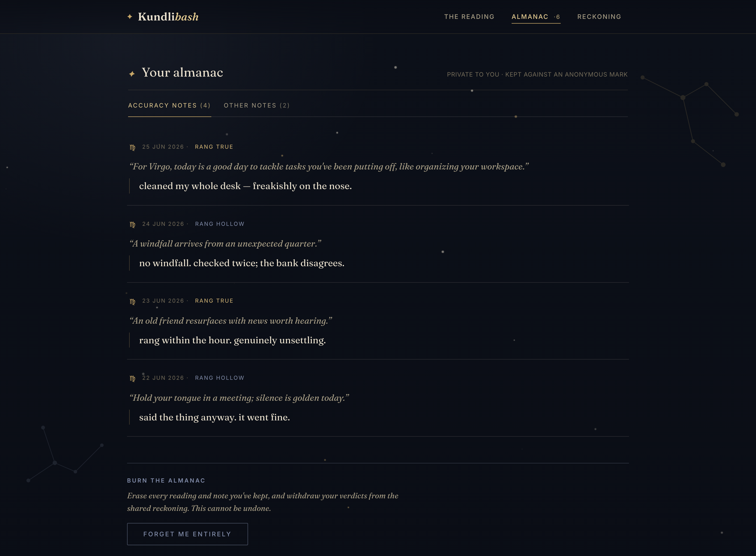
✦
THE ALMANAC
Three quiet ledgers.
Accuracy notes
Per line: the verdict, the original prediction, and what actually happened.
Other notes
Free-form notes for the day — the mood, the omen, what the reading missed.
Stats
Your accuracy and streak; the whole zodiac ranked by candour.
KUNDLIBASH
06

Slide 7
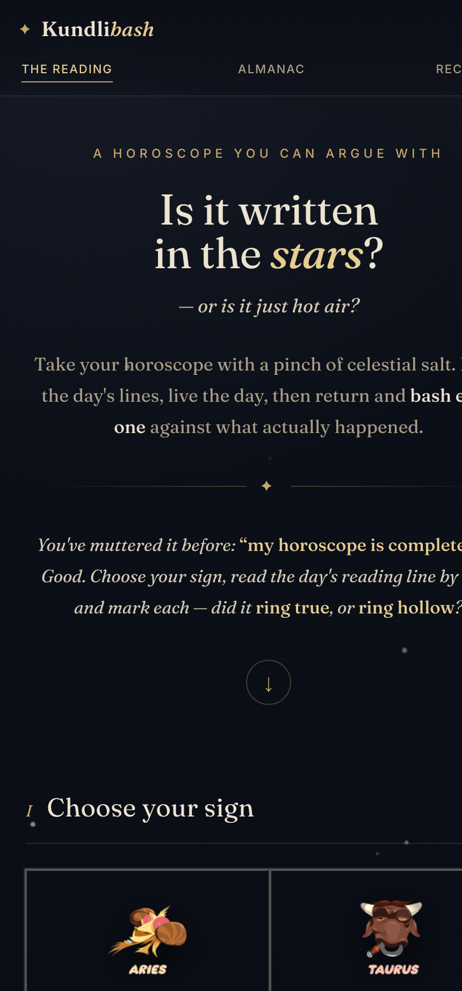
✦
WHY IT WORKS
Habit, truth, and almost no upkeep.
✦
A daily loop
A fresh reading every day is a reason to return — and to bash yesterday's.
✦
Shared truth
One reading per sign per day makes the community scoreboard a fair contest.
✦
Light to run
Static front end, serverless functions, one key-value store. Scales to zero.
KUNDLIBASH
07

Slide 8
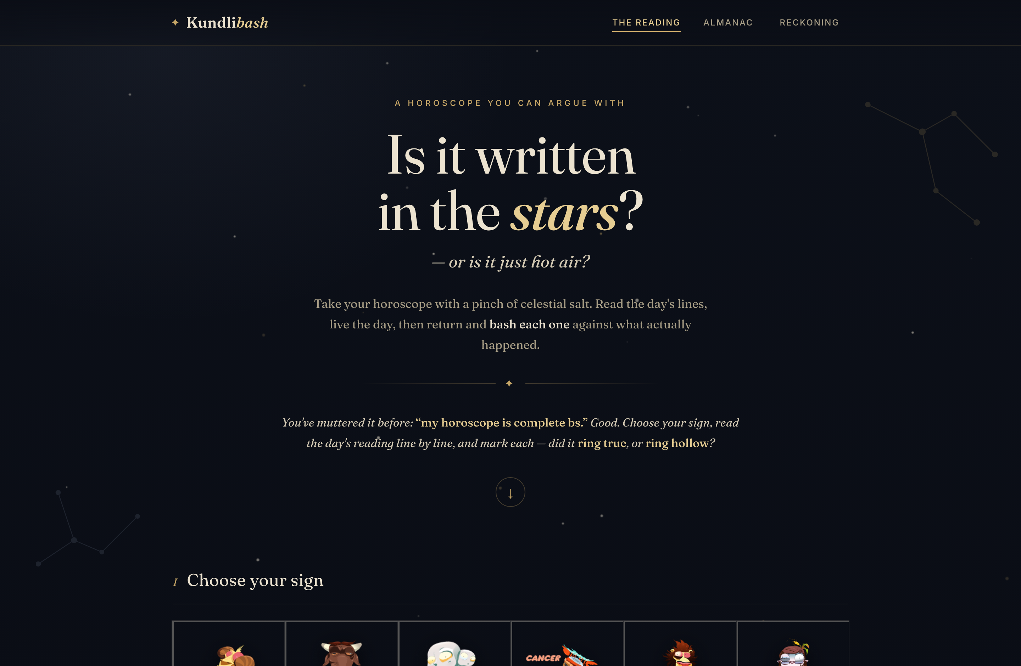
✦
UNDER THE HOOD
Already built. Ready to ship.
FRONT END
One static HTML page — a vanilla-JS single-page app, no framework.
BACK END
Cloudflare Pages Functions — a handful of serverless endpoints.
STORAGE
One KV namespace holds predictions, verdicts and tallies.
IDENTITY
An anonymous cookie. No accounts, no email, no PII.
PREDICTIONS
Live astrology APIs with fallback, cached once per sign per day.
Runs on Cloudflare for ~nothing, and scales to zero at rest.
KUNDLIBASH
08

Slide 9
✦
WHAT'S NEXT
Where it goes.
✦
Weekly & monthly reckonings Accuracy trends over time, per sign.
✦
Share cards A beautiful auto-made image of today's verdict or your streak.
✦
Sign rivalries “Virgo vs Scorpio — who's more full of it this week?”
✦
Claimable accounts Carry your anonymous almanac across devices.
✦
An editorial layer A short written reading of the readings, in Akhil's voice.
KUNDLIBASH
09

Slide 10
✦
Take your horoscope with a
pinch of celestial salt.
kundlibash.pages.dev
For diversion, not counsel. · Built with Claude Code.

